Slide 1
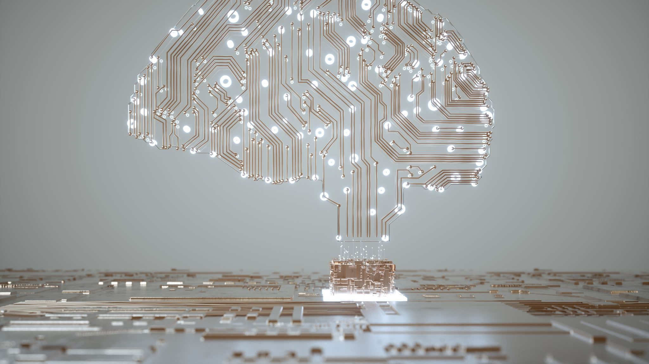
Artificial Intelligence (AI)
Year 3 - 4

Slide 2

What is supervised learning?
The image is called the input, and the correct answer is known as the label in supervised learning. Supervised learning is when a computer learns by looking at examples that already have answers.
After seeing enough examples (and getting enough practice), the computer begins to guess correctly without being told the right answer.

Slide 3

Training our own AI Model
On Machine Learning for Kids (ML4K), you are going to use images to train an AI model to identify and label an image between two or three categories (eg: between dogs, hamsters, rats or cats, rock, paper or scissors)
https://machinelearningforkids.co.uk/#!/login

Slide 4
Testing the Model
Where did it succeed?
Where did it fail?
Why did mistakes happen?
How to improve the data to reduce errors?

Slide 5
Issues with Data
Perspective: The point of view from which the data comes (eg: An Australian may only provide animals from Australia, so the AI believes these are the only animals that exist).
Bias: Providing an unfair or one-sided opinion that doesn’t reflect everyone else's opinion (eg: only interviewing and getting girls' favourite artists, leading the AI to assume males would have the same favourite artists).

Slide 6
AI limitations
AI can make mistakes, especially if it sees something new or unusual
AI can help, but not replace human thinking, and you must check and correct AI at times
For example, AI may recommend a video on YouTube but we decide if it’s right for us

Slide 7
AI Ethics
Ethics means knowing the difference between right and wrong
AI doesn’t have feelings or values, so bases its decisions on data, which may not always be the best decision
Discuss: Should AI decide who gets a job?

